Slide 1

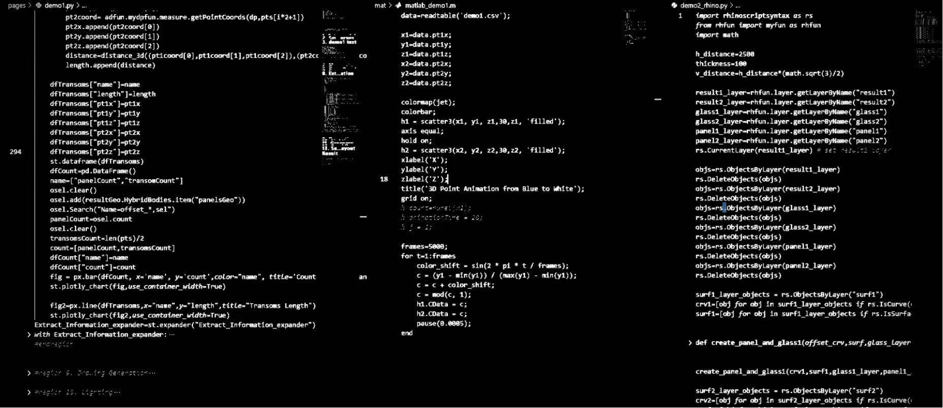

Master Challenge – Andy Zhu
Application No: 1305753795
Standards? Just the foundation—critical, yes, but basic. Automation is the unstoppable core of BIM (Building Information Modeling), powering efficiency and precision, obliterating tedious tasks, and supercharging workflows. Breakthroughs and innovation? They’re the blazing soul of BIM, shattering limits, igniting bold creativity, and unleashing game-changing possibilities. But make no mistake—the BIMer is the ultimate force here. They don’t just use these tools, they command them, fusing structure, efficiency, and genius into a revolution. BIM isn’t just a process—it’s a powerhouse, and the fearless BIMer drives its true, world-shaping potential.

